Slide 1
A 5G experimental environment focused on vertical applications
Diego R. Lopez, Telefónica I+D
5GINFIRE has received funding from the European Horizon 2020 Programme for research, technological development and demonstration under grant agreement no 732497

Slide 2
Emerging Trends in 5G
One network to support all cases
  Focused on vertical industry requirements
Consolidation of base technologies
  Software Network
  NFV + SDN
  Edge Computing
  …
The challenge of operationalization
  Supporting vertical users
  5GINFIRE is committed to build and operate an open and extensible 5G NFV-based ecosystem of experimental facilities

Slide 3
Requirements for the Facility
Adopt and be interoperable with current standards
  Cloud, SDN, NFV, MEC…
Use open standards and integrate technologically mature, widespread open source toolsets
  Hence OSM
Simplify the deployment of experimentation scenarios
  And guarantee repeatability
Enable vertical experimenters at all levels
  Applications, services or VNFs
  5G-enabled experimentation infrastructure also able to support specialized infrastructure for verticals

Slide 4
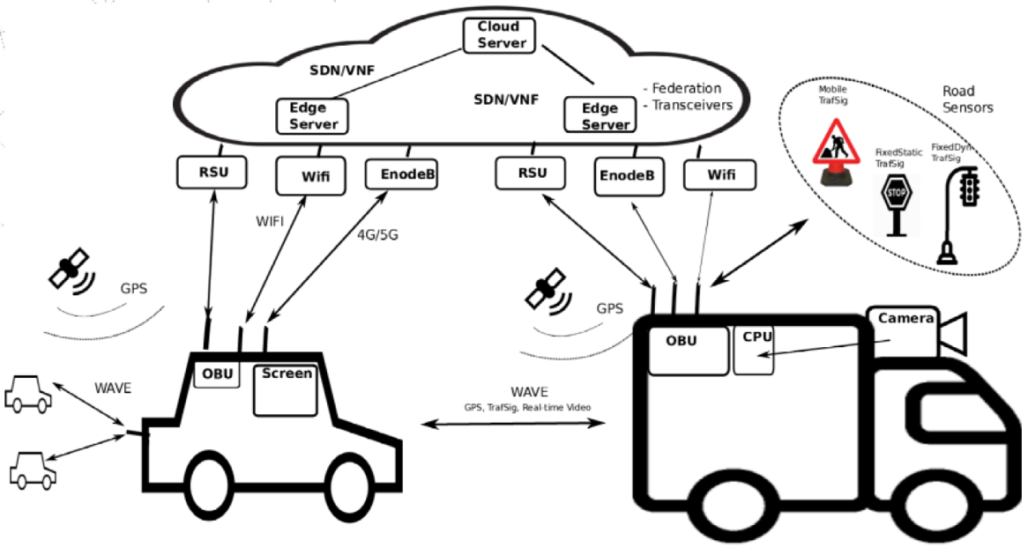
Targeted Use Case
Assisted Overtaking

Slide 5
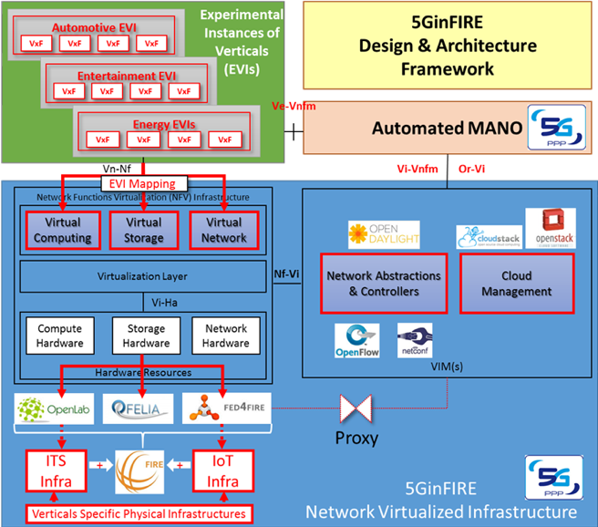

5GinFIRE Reference Model
Open source components
  OpenStack, OpenDaylight…
  OSM
Integrating infrastructures from verticals
Generalizing the concept of VNFs taking into account functionalities other than network
  Vertical focus
  Introducing VxFs
  Universal management of virtual functions
Automated deployment of VxFs
  Dedicated VxF stores

Slide 6
Actors in an Experiment Workflow
Experimenter
Create account
Create experiment
Select/Deploy
VxFs
Experiment
description
Upload
Submit for validation
Get access to testbed resources, Monitor,
experiment
Access revoked
Results available
Notify
Schedule etc.
Iterate
5GinFIRE operations
Submit
Approved
Authorize
account
Validate experiment
Schedule/
Create
deployment
Orchestrate
deployment
Manage
deployment
Release
experiment
5GinFIRE
Testbed providers
Validate experiment
(feasibility schedule dates, etc.)
Manage resources/installations etc.

Slide 7
Middleware and Portal Features
Single point of interaction for experimenters
  Manage and monitor experiments
  Update and browse the VxF repository
Support for 5GINFIRE admins
  5GINFIRE platform and repository
Gatekeeper for VxF developers
  Support a DevOps approach
Model-based
  Map experiment descriptors onto NSDs
  Consistent verification and deployment
Integration with other testbeds
  Enabling the creation of federated experiments (Fed4FIRE)
  5GINFIRE repository accessible through other FIRE catalogues

Slide 8
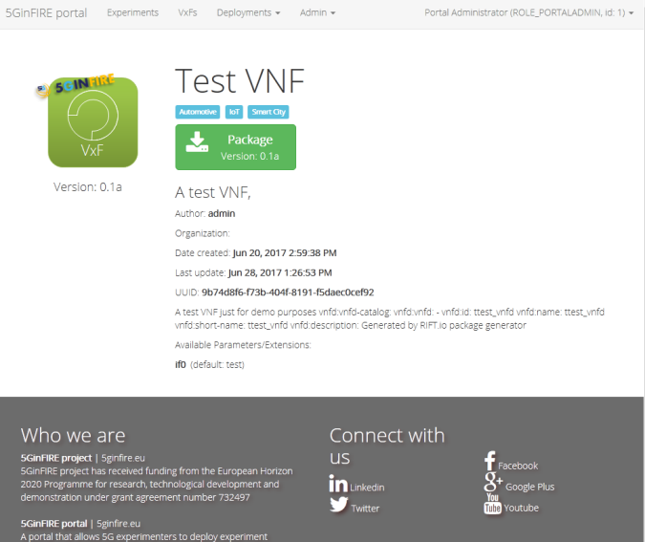
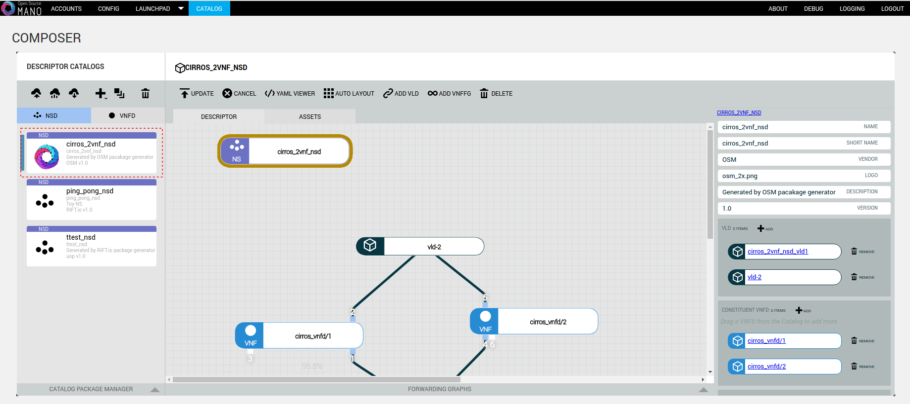
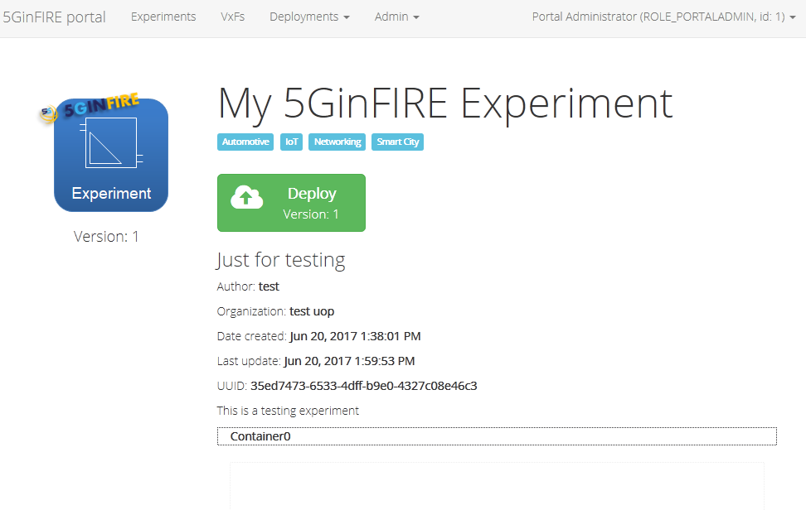
The 5GinFIRE Portal
Portal API backend
Portal web
frontend
API
OSM
(launchpad) client API
API
OSM
YANG RIFT.IO model to Java
Angular
JavaWS
IDP
Public VxF descriptors repository

Slide 9
The 5GinFIRE NFVO
OpenStack Ocata
5TONIC datacenter
VIM
OSM
Release TWO
ITAv datacenter
OSM stack
VIM
Other datacenters
(UFU & open calls)
UNIBRIS/BiO datacenter
VIM

Slide 10
Control Plane Connectivity
VIM management
Infrastructure management
Telco/VNF management
VIM
Compute
nodes
UC3M
VIM
NAT
OSM
stack
NFVI
Data Plane Switch
VPN
ITAv
VIM
UNIVBRIS
Compute
nodes
Compute
nodes
NFVI
Data Plane Switch
NFVI
Data Plane Switch
VIM

Slide 11
Orchestration @ 5TONIC
VPN gateway
∂∂©
Internet
Relesase TWO
Public cloud nodes
Ocata
Ocata
Additional infrastructure (not shown in the figure):
  3x server computers to support complementary functionalities, such as aiding experimentation (e.g. hosting client applications), deployment of a network management system (e.g, Nagios, Check_MK), data storage (e.g. backups, VM images or code), etc.
Compute
nodes
Compute
nodes
IMDEA
NFVI
5GINFIRE
NFVI
Data Plane Switch
Data Plane Switch

Slide 12
What Could Come to OSM
Validation in a 5G playground
  Interaction with 5G OSS-like environments, including the slice matters
  Multi-* (VIM, VCA, RO, domain, tenant, tier…) operation
  With vertical, layman users
  Testing of new features in this and coming releases
Explore DevOps lifecycles and mediation elements
  Incorporate Verification & Validation procedures to service lifecycles
  Application of intent declarations in combination with descriptors
Security enhancements
  Security models
  Token services
  Assured auditability
Additional application environments
  Micro VNFs

Slide 13

Virtuous Circles
Open source is a natural way to make available research project results
  And to increase their impact on standardization
Research projects open new ways for the evolution of open source
  Stretching the scopes
  Exploring additional scenarios and technologies
Network function and service orchestration is a hot research topic
  With 5G as the flagship
As long as we define proper (and simple) rules of engagement
  Take the software, do whatever you feel like with it
  Come back to the community, make your case
  Abide to upstream community practice

Slide 14
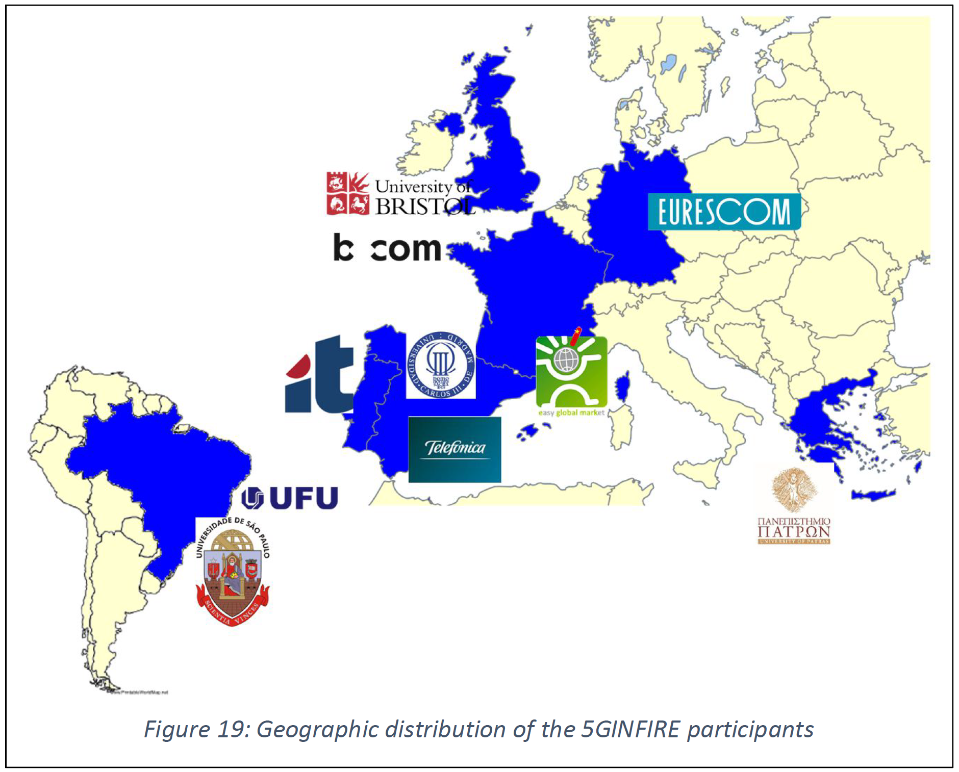
‘Nuff said!
https://5ginfire.eu/
contact@5GinFIRE.eu
https://twitter.com/5GinFIRE
5GINFIRE has received funding from the European Horizon 2020 Programme for research, technological development and demonstration under grant agreement no 732497

