Slide 1

Service Function Chaining
Feature Proposal
Jayaprakash G(Tata Elxsi) 02-Feb-2023

Slide 2
Service Function Chaining
SFC is the ability to cause network packet flows to route through a network via a path other than the one that would be chosen by routing table lookups on the packet’s destination IP address.
A very simple example of a service chain would be one that forces all traffic from point A to point B to go through a firewall even though the firewall is not literally between point A and B from a routing table perspective.
            User Plane Traffic Path
.
5G Core
Firewall
UE
gNB
UPF
Internet
2

Slide 3
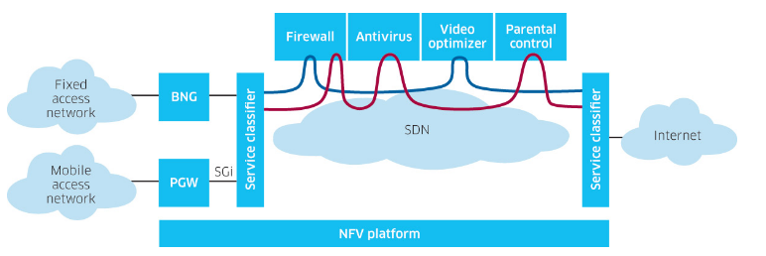
SFC Use Case
3

Slide 4
Why SFC in Orchestrator?
To define and modify the service function chaining policy that defines the path to steer traffic policies.
Management of service function chaining from Orchestrator- Creating SFC, Viewing SFC, Modifying SFC, Deleting SFC.
Note : SFC prototype was available in REL8 and was not replicated in subsequent releases
4

Slide 5

Thank you!

Slide 6
Chaining the path without SFC
Chaining the Path without SFC feature
  Physically placing SNs on data path of underlay, or
  Changing the forwarding of underlying network to "steer" packets through service chain
  Disadvantages
Increasingly inflexible/painful deployment model
  Requires changing forwarding behavior of underlay, or
  Requires physical placement of SF on data path
6

Slide 7
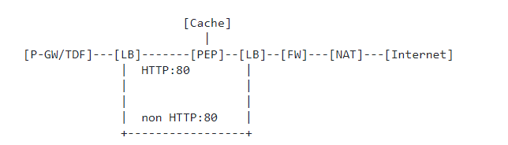
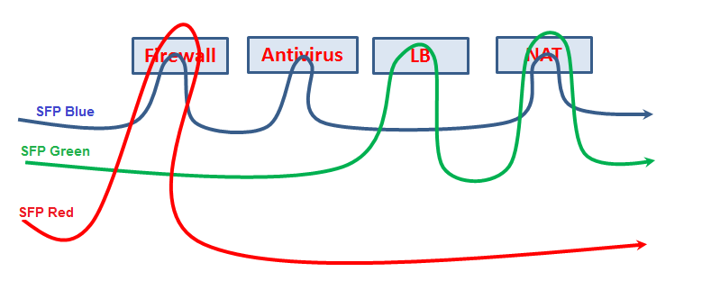
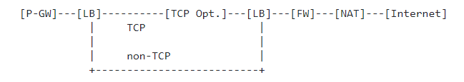
SFC Use Case
In Mobile Network
Service function chain model for Internet HTTP services
Service function chain for TCP optimization
b) In Corporate Network
- VPN services
7

